Slide 1

SCHOOL OF COMPUTING
DEPARTMENT OF COMPUTER SCIENCE AND ENGINEERING
10211CS130 : FUNDAMENTALS OF COMPUTER NETWORKS
S10
Dr.T.Vijayanandh

Slide 2
Unit 2
Physical Layer
Types of errors
Error detection and correction techniques,
Flow control mechanism,
Multiple access protocols,
Link layer addressing.
Media Access Control
frame format, types, cloning.
IEEE 802.3 – frame format, types.

Slide 3
ERROR
Networks must be able to transfer data from one device to another with complete accuracy.
Some part of a message will be altered in transit than that the entire content will arrive intact.
Many factors like line noise can alter or wipe out one or more bits of a given data unit.
This is known as errors.

Slide 4
TYPES OF ERRORS
Error control mechanism may involve two possible ways:
Error detection
Error correction
1. Single Bit Error
2. Multiple bits error
3. Burst Bit Error

Slide 5
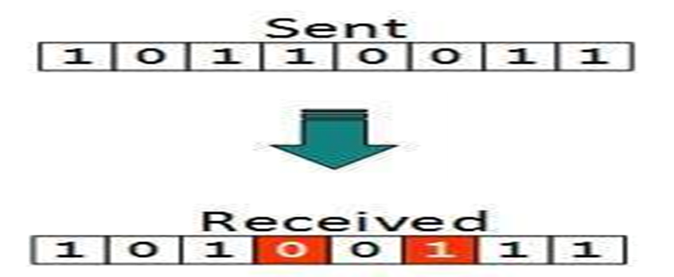
In a frame, there is only one bit, anywhere though, which is corrupt.
Frame is received with more than one bit in a corrupted state.
Frame contains more than 1 consecutive bits corrupted.

Slide 6
ERROR DETECTION
ERROR DETECTION : For reliable communication errors must be detected and corrected. For error detection we are using many mechanisms.

Slide 7
REDUNDANCY

Slide 8
REDUNDANCY TYPES
Four types of redundancy checks are used in data communications. They are,
1. Vertical Redundancy Check (VRC)
2. Longitudinal Redundancy Check (LRC)
3. Cyclic Redundancy Check (CRC)
4. Checksum

Slide 9
: 0 :
NO ERROR
: 1 :
ERROR

Slide 10
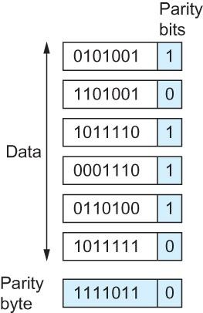
1. Vertical Redundancy Check (VRC)
Add
ODD 1s :
Even 1s :
1
It is also known as a parity check.
Perhaps the most familiar error-detecting code is the parity-check code.
This code is a linear block code.
0

Slide 11
Error Detection
Simple Parity Check
Data sent from the sender undergoes parity check :
1 is added as a parity bit to the data block if the data block has an odd number of 1's.
0 is added as a parity bit to the data block if the data block has an even number of 1's.
This procedure is used for making the number of 1's even. And this is commonly known as even parity checking.

Slide 12
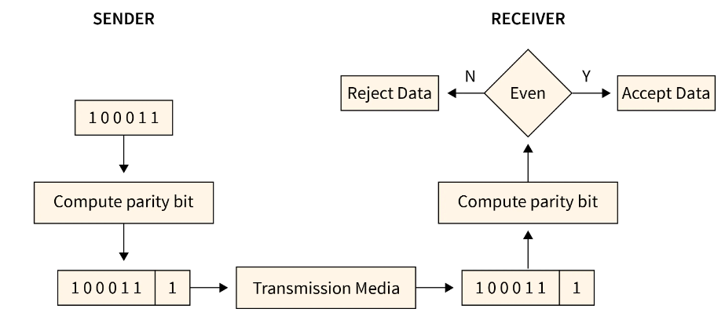
Simple Parity Check

Slide 13
Two-Dimensional Parity Check
For every row and column, parity check bits are calculated by a simple method of parity check.
Parity for both rows and columns is transmitted with the data sent from sender to receiver.
At the receiver’s side, parity bits are compared with the calculated parity of the data received.

Slide 14
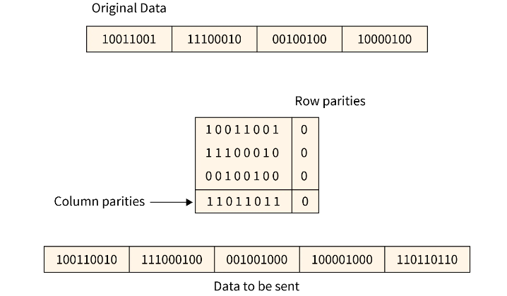
Two-Dimensional Parity Check

Slide 15
Checksum
Checksum is a error detection which detects the error by dividing the data into the segments of equal size
Then use 1's complement to find the sum of the segments
Then sum is transmitted with the data to the receiver and same process is done by the receiver
And at the receiver side, all zeros in the sum indicates the correctness of the data.

Slide 16
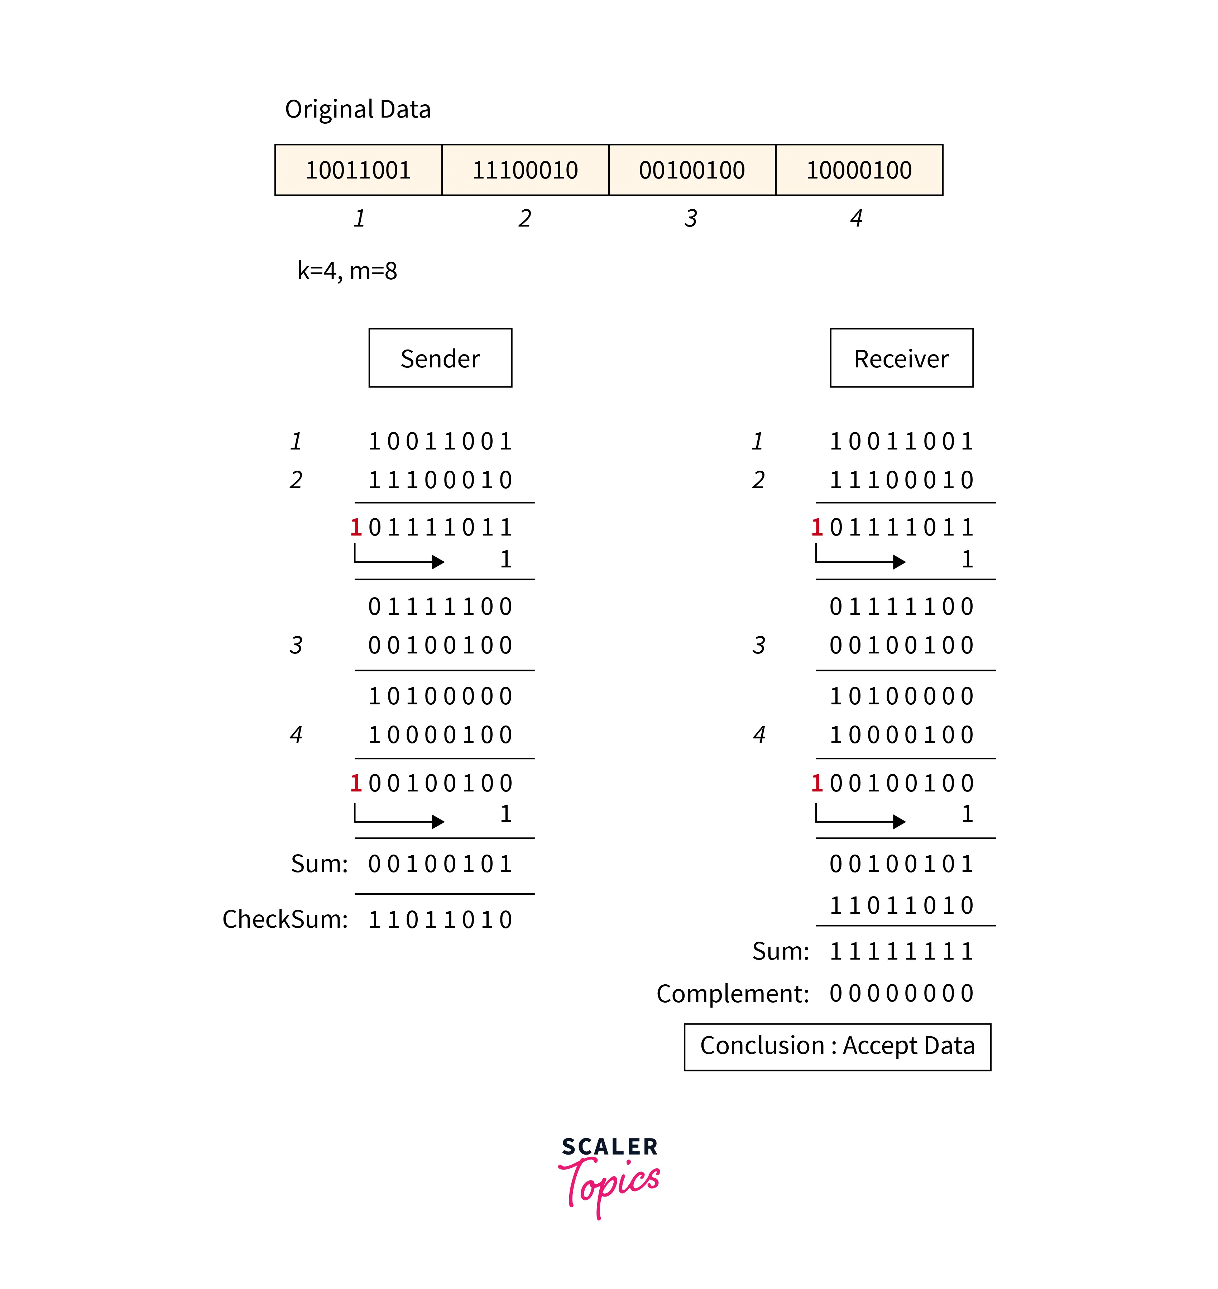
Checksum

Slide 17
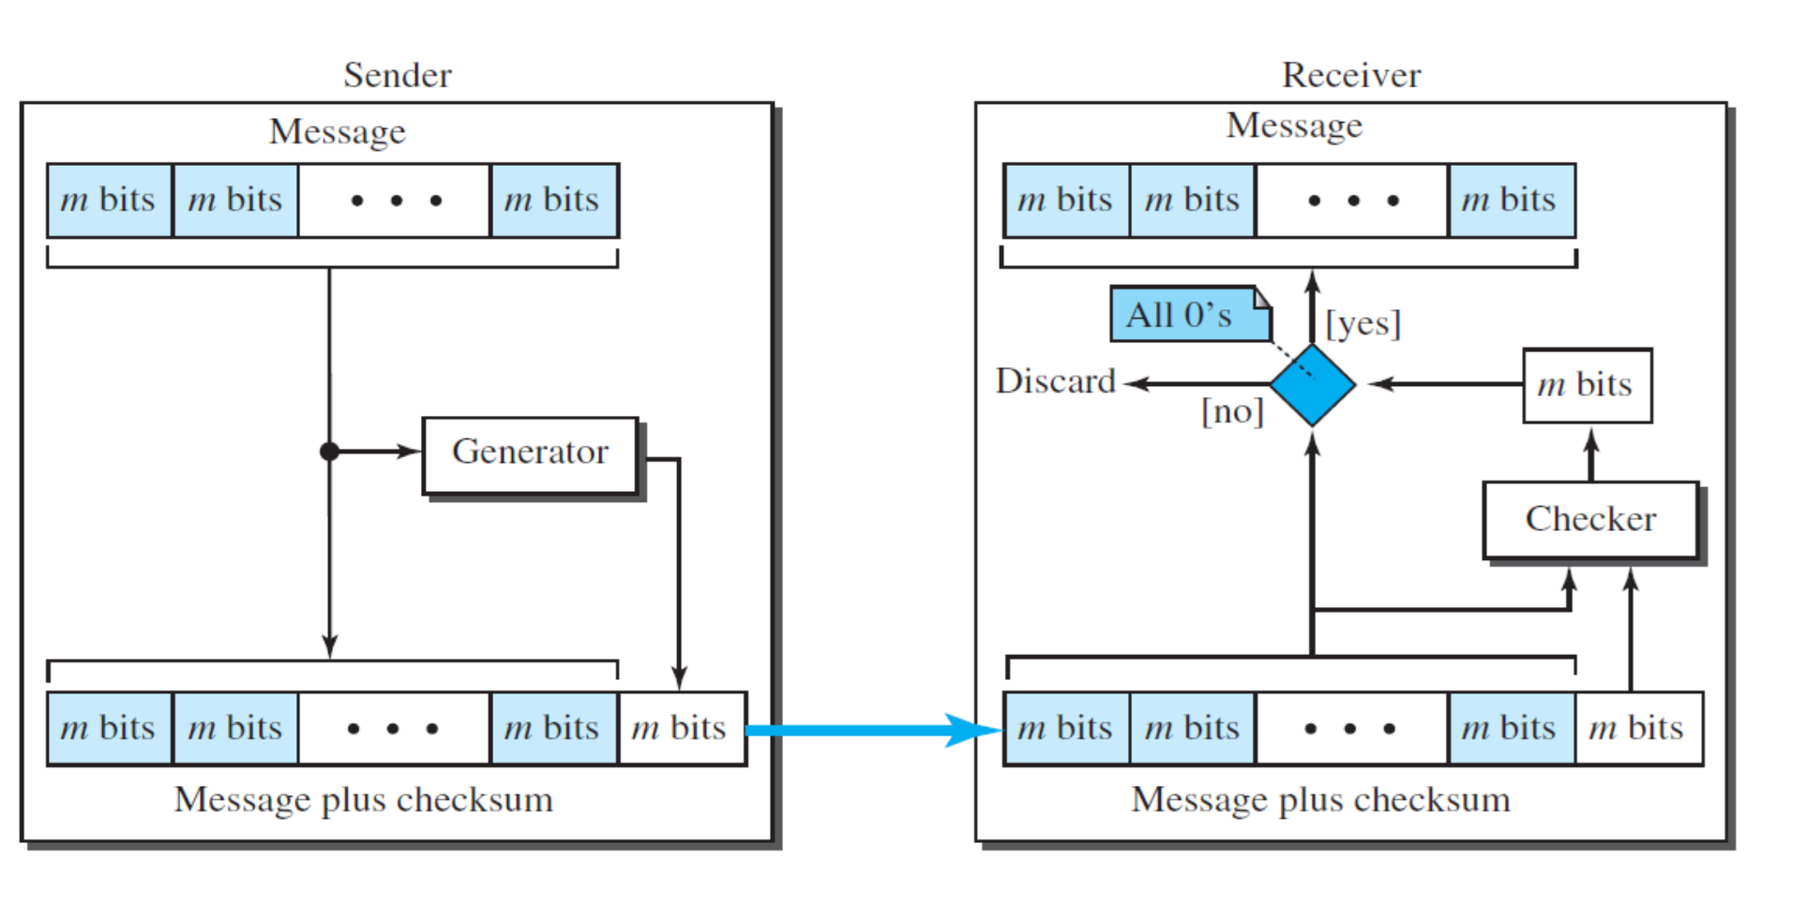
4. Checksum

Slide 18
training
DATAWORD | CODEWORD

Slide 19
Encoder and decoder for simple parity-check code

Slide 20
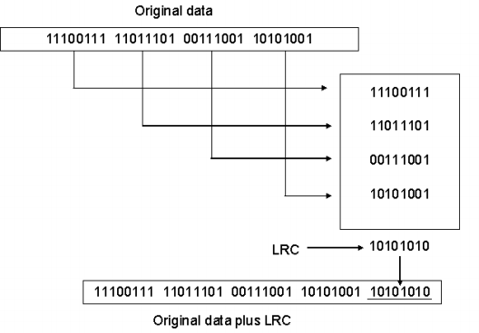
2. Longitudinal Redundancy Check (LRC)
In this, a block of bits is organized in a table

Slide 21
CYCLIC CODES
Cyclic codes are special linear block codes with one extra property.
In a cyclic code, if a codeword is cyclically shifted (rotated), the result is another codeword.
1 0 1 1 0 0 0 is a codeword
cyclically left-shift
0 1 1 0 0 0 1 is a codeword

Slide 22
3. Cyclic Redundancy Check (CRC)
CRC is a different approach to detect if the received frame contains valid data.
This technique involves binary division of the data bits being sent.
The divisor is generated using polynomials.
The sender performs a division operation on the bits being sent and calculates the remainder.
Before sending the actual bits, the sender adds the remainder at the end of the actual bits.
Actual data bits plus the remainder is called a codeword.
The sender transmits data bits as codewords.

Slide 23
CRC encoder and decoder

Slide 24
(x3 + x2 + x + 1) / (x4 + x2 + x + 1)
/
(x5 + x3 + x + 1) / (x4 + x3 + x + 1)
/
(x5 +x3 + 1) / (x4 + x2 + x + 1)
/
(x3 + x2 + x + 1) / (x2 + 1)
/
(x5 + x2 + x + 1) / (x4 + x2 + x )
/
(x5 + x3 + x + 1) / (x3 + x2+1)
/

Slide 25
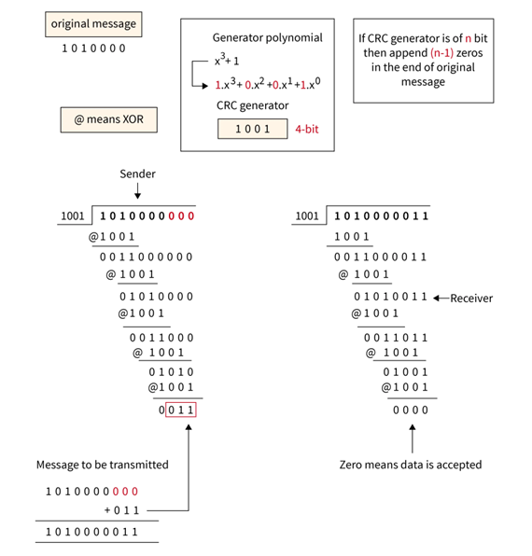

Slide 26
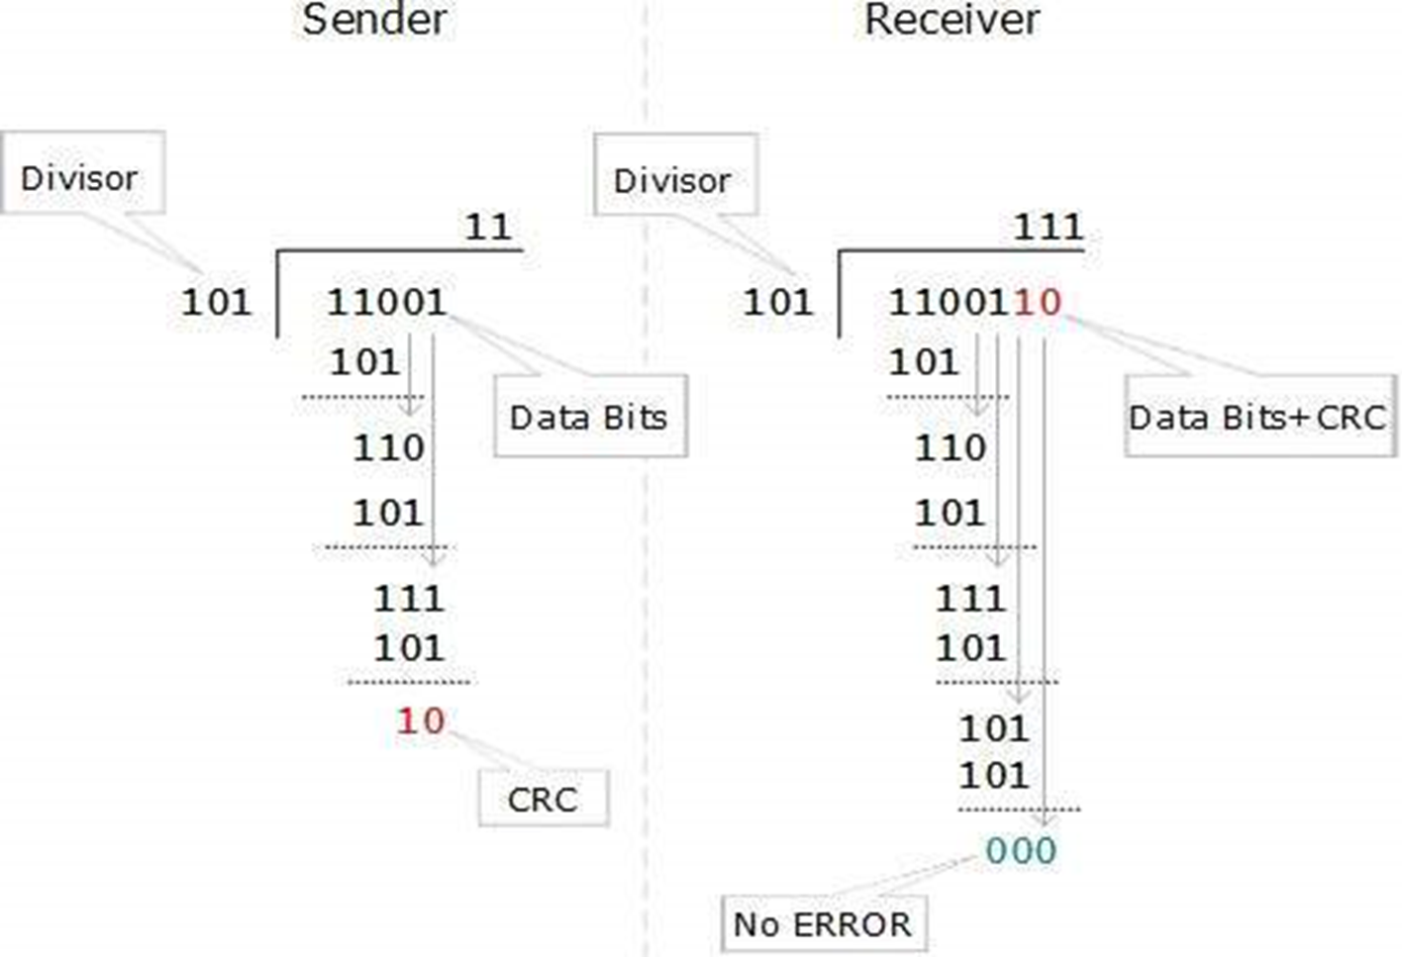

Slide 29
Apply Cyclic Redundancy Check (CRC) Encoding and decoding with the corresponding polynomials:
(x3 + x2 + x + 1) / (x4 + x2 + x + 1)
/
(x5 + x3 + x + 1) / (x4 + x3 + x + 1)
/
(x5 +x3 + 1) / (x4 + x2 + x + 1)
/
(x3 + x2 + x + 1) / (x2 + 1)
/
(x5 + x2 + x + 1) / (x4 + x2 + x )
/
(x5 + x3 + x + 1) / (x3 + x2+1)

Slide 30
Hamming Code
Parity bits: The bit which is appended to the original data of binary bits so that the total number of 1s is even or odd.
Even parity: To check for even parity, if the total number of 1s is even, then the value of the parity bit is 0. If the total number of 1s occurrences is odd, then the value of the parity bit is 1.
Odd Parity: To check for odd parity, if the total number of 1s is even, then the value of parity bit is 1. If the total number of 1s is odd, then the value of parity bit is 0.
Algorithm of Hamming code:
An information of 'd' bits are added to the redundant bits 'r' to form d+r.
The location of each of the (d+r) digits is assigned a decimal value.
The 'r' bits are placed in the positions 1,2,.....2k-1.

Slide 31
Hamming Distance
The Hamming distance between two words (of the same size) is the number of differences between the corresponding bits.
Codeword 00000 Sent Codeword 01101 is Received
00000
01101
A 01101
No of 1s is : 3
(Hamming Distance =3)
If the Hamming distance between the sent and the received codeword is not zero, the codeword has been corrupted during transmission.
A | B | AA B
0 | 0 | 0
0 | 1 | 1
1 | 0 | 1
1 | 1 | 0

Slide 32
What is the Hamming distance for each of the following codewords?
A | B | AA B
0 | 0 | 0
0 | 1 | 1
1 | 0 | 1
1 | 1 | 0
d (10000, 00000) = 10000 = 1
d (10101, 10000) = 00111 = 3
d (00000, 11111) = 11111= 5
d (00000, 00000) = 00000=0 Net ID
d (11111, 11111) = 00000=0 Broadcast ID

Slide 33

Error Correction In the digital world, error correction can be done in two ways:
Backward Error Correction When the receiver detects an error in the data received, it requests back the sender to retransmit the data unit.
Forward Error Correction When the receiver detects some error in the data received, it executes error-correcting code, which helps it to auto-recover and correct some kinds of errors.

Slide 34
Flow Control
In flow control, rate of traffic received from a sender can be controlled by a receiver.
Flow control is a technique used to regulate the flow of data between different nodes in a network. It ensures that a sender does not overwhelm a receiver with too much data too quickly.
The goal of flow control is to prevent buffer overflow, which can lead to dropped packets and poor network performance.
When a data frame (Layer-2 data) is sent from one host to another over a single medium, it is required that the sender and receiver should work at the same speed.

Slide 35
Flow Control (Conti.. )
The sender sends at a speed at which the receiver can process and accept the data.
What if the sender or receiver's speed (hardware/software) differs? If the sender is sending too fast, the receiver may be overloaded (swamped), and data may be lost.
Two types of mechanisms can be deployed to control the flow:
Stop and Wait
Sliding Window

Slide 36
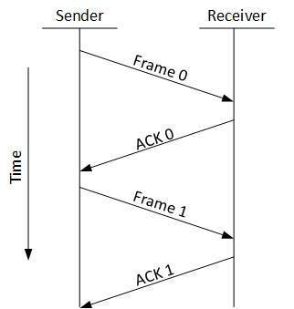


Stop and Wait
This flow control mechanism forces the sender after transmitting a data frame to stop and wait until the acknowledgement of the data-frame sent is received.
We can’t use this at full speed due to the limitations of stop and wait.
The Stop and Wait for ARQ offers error and flow control but may cause big performance issues as the sender always waits for acknowledgement even if it has the next packet ready to send.

Slide 37
Sliding Window
Sliding Window Protocol is a method for sending numerous frames at once in the sliding window.
It manages the data packets between the two devices when steady and gradual data frame transmission is required.
In this flow control mechanism, both sender and receiver agree on the number of data frames after which the acknowledgement should be sent.
As we learnt, the stop-and-wait flow control mechanism wastes resources. This protocol tries to make use of underlying resources as much as possible.
Window Sliding Technique is a computational technique that aims to reduce nested loops and replace them with a single loop, thereby reducing the time complexity.

Slide 38

Sliding Window protocol handles this efficiency issue by sending more than one packet at a time with a larger sequence number.
Transmission Delay
Propagation Delay
Efficiency
Throughput
Capacity of link

Slide 39
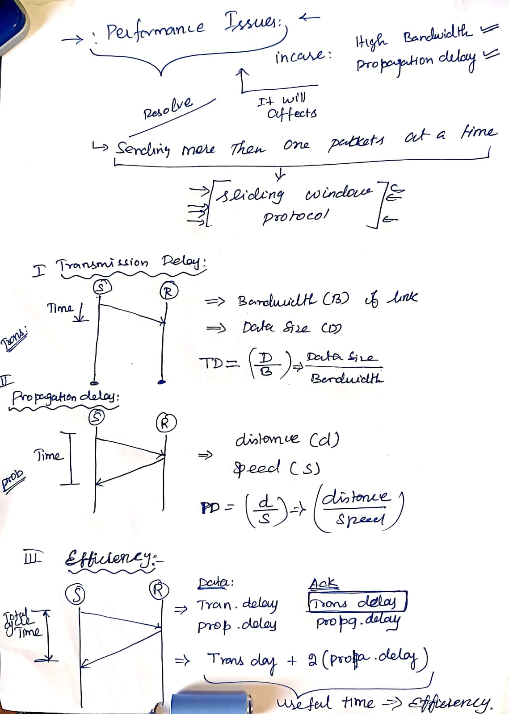
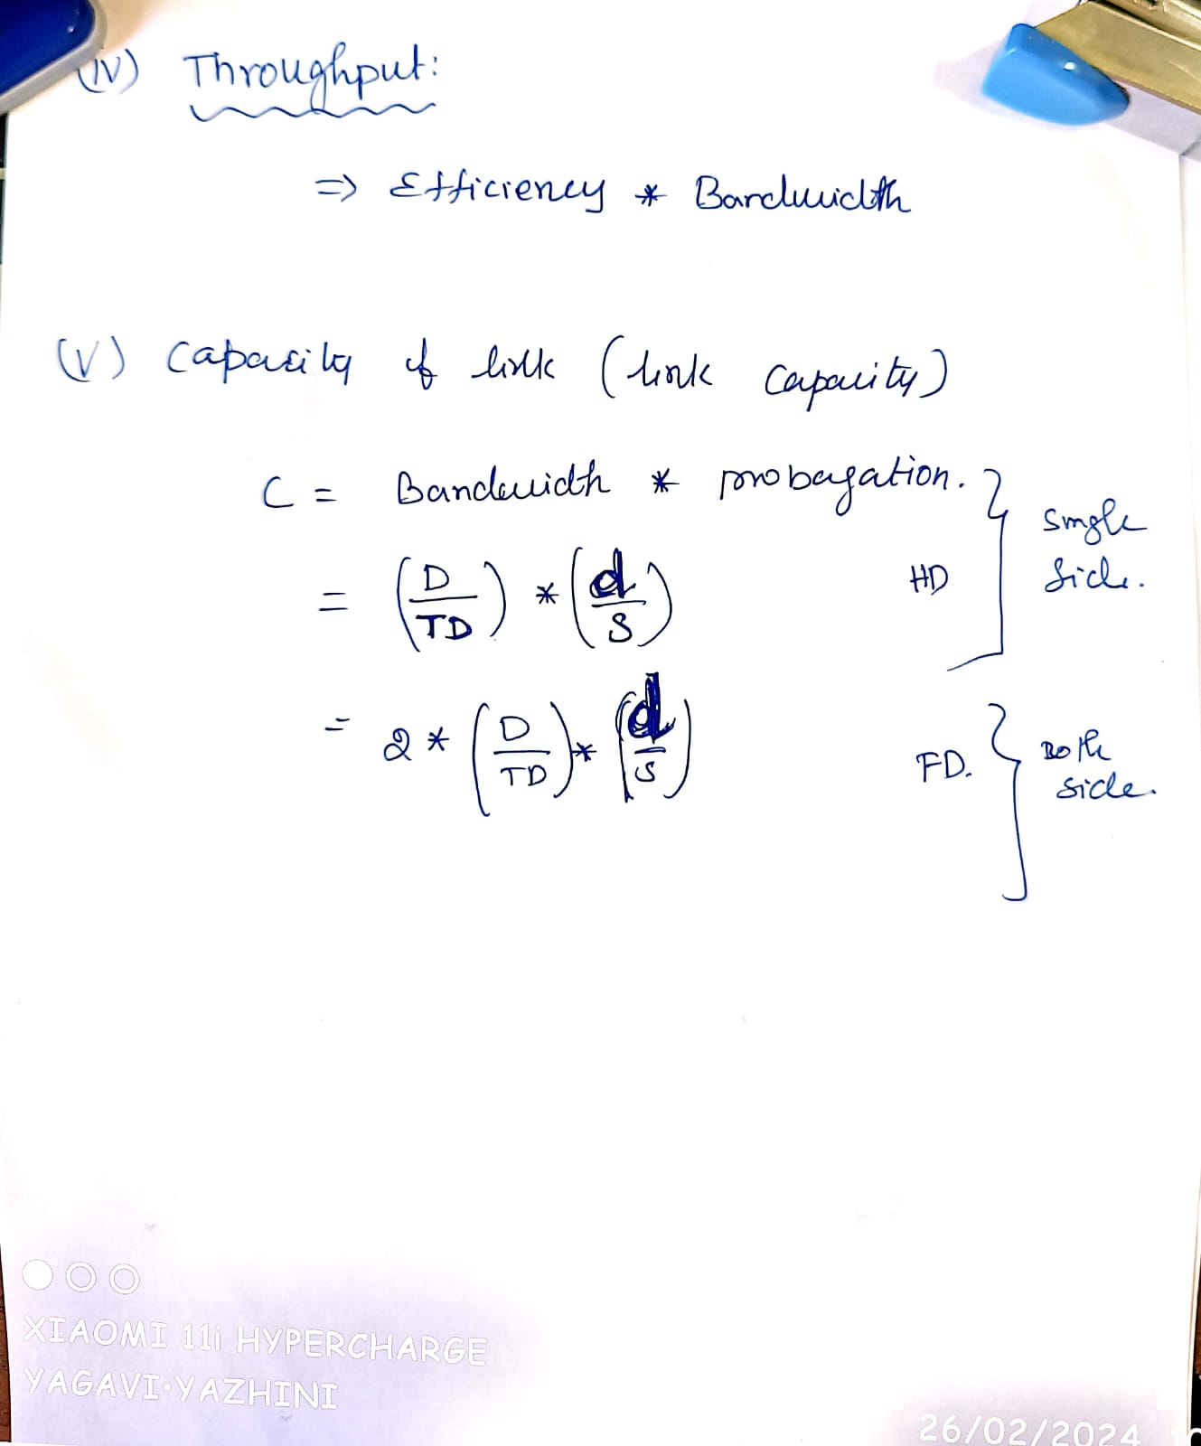

Slide 40
we have discussed sending window only
For the receiving window, there are some protocols, namely
Go Back N and
Selective Repeat

Slide 41
Error Control
Error detection - The sender and receiver, either both or any, must ascertain that there is some error in the transit.
Positive ACK - When the receiver receives a correct frame, it should acknowledge it.
Negative ACK - When the receiver receives a damaged frame or a duplicate frame, it sends a NACK back to the sender and the sender must retransmit the correct frame.

Slide 42
Retransmission: The sender maintains a clock and sets a timeout period. If an acknowledgment of a data frame previously transmitted does not arrive before the timeout, the sender retransmits the frame, thinking that the frame or it’s acknowledgment is lost in transit.
There are three types of techniques available which Data-link layer may deploy to control the errors by Automatic Repeat Requests (ARQ):
Stop-and-wait ARQ
Go-Back-N ARQ
Selective Repeat ARQ

Slide 43
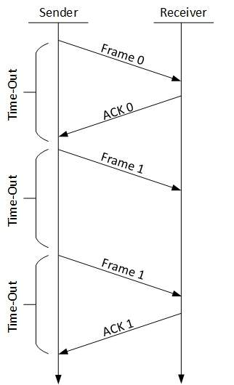
Stop-and-wait ARQ

Slide 44
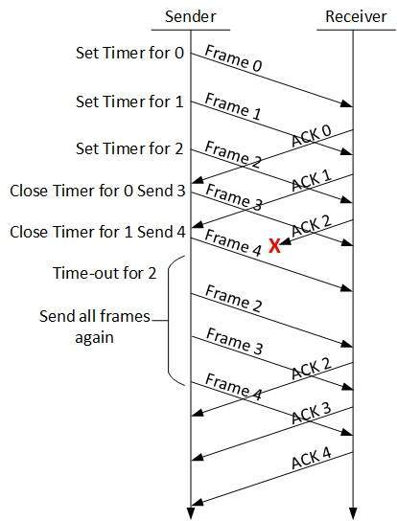
Go-Back-N ARQ

Slide 45
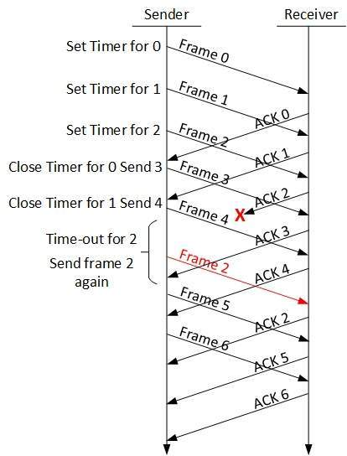
Selective Repeat ARQ

